Slide 1
Rating Prediction using user Reviews Project
By Khushboo Khatri

Slide 2
Index
Introduction
Data Collection
Pre processing with NLP
Model Development and Evaluation
Conclusion

Slide 3
Introduction
With brands vying to win customers over with aggressive marketing, online reviews have become an important consideration for consumers. A large group of Ecommerce shoppers buy only after reading reviews of products. Product ratings and reviews secure the customer journey by giving them the confidence to complete the checkout process. User-generated content provides valuable consumer insights. It helps Ecommerce retailers understand the needs of consumers. Brands can use this information to ideate, improve and innovate products or services, foster customer loyalty, and improve their business.

Slide 4
Business Problem Framing:
We have a client who has a website where people write different reviews for technical products. Now they are adding a new feature to their website i.e. The reviewer will have to add stars(rating) as well with the review. The rating is out 5 stars and it only has 5 options available 1 star, 2 stars, 3 stars, 4 stars, 5 stars. Now they want to predict ratings for the reviews which were written in the past and they don’t have a rating. So, we have to build an application which can predict the rating by seeing the review.

Slide 5
Data Collection
We collect the data by using web scraping tool on flipkart.com.
The main data which is required is Reviews and their corresponding Rating, and this is what we scrape for various technical products using Selenium.
We collect around 31405 data for reviews and ratings, which seems to be decent dataset to work with.

Slide 6
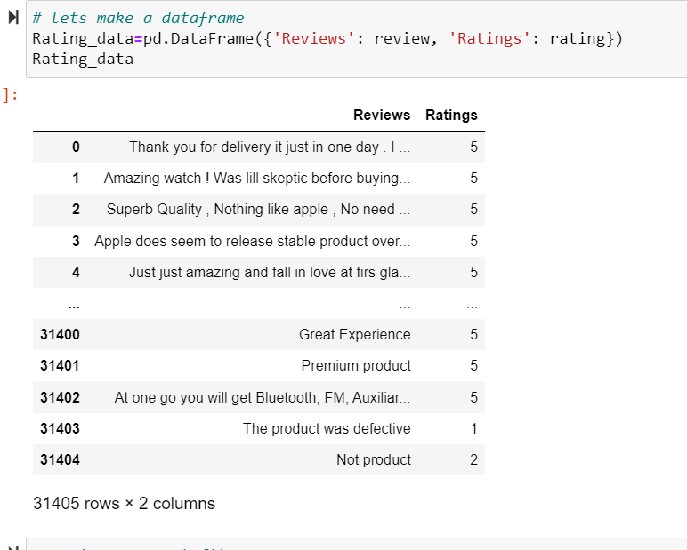
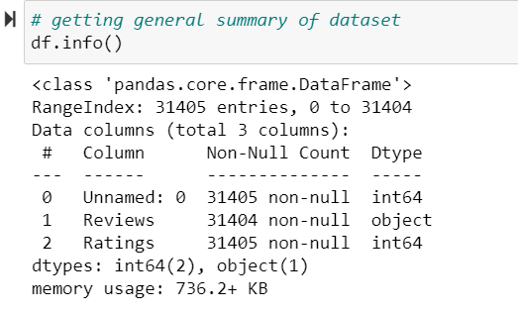
Collected data and its data type

Slide 7
Pre Processing with NLP
We starts with some visualization or EDA, here our target column along is numerical data type and our feature column is text type. So visualizing text data need some pre processing, therefore we will start with analysing our label column which is rating.
Rating is multiclass label, so its very important to see how data is distributed among these various classes of our label data.

Slide 8
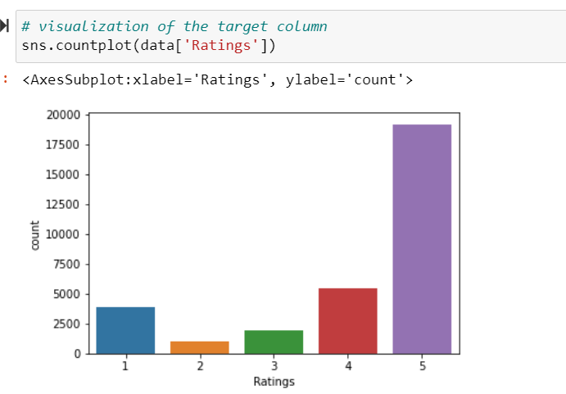
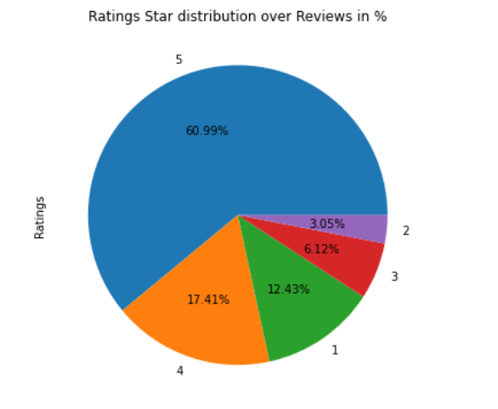
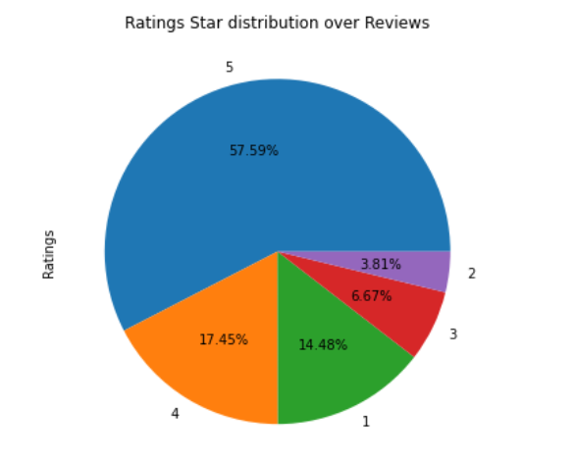
The second pie plot, indicates the distribution of data after we drop the duplicates from the dataset.
Which slightly improve the distribution of data among the classes of this multiclass label.

Slide 9
Data Cleaning and pre processing of feature column(reviews)
For making text column ready for the model we need to pre processed the text using NLP method. In this method we follow certain techniques which helps us to make this text data into clean data which is useful and understandable by the machine. Steps follows to make data clean and pre processed are:
Converting all the strings into lower case
Replacing all the email address with email, , URLS with webaddress.
Replacing all the money symbol, phone numbers, numbers, punctuation.
Removing white spaces, single spaces, trails.
Removing all the stopwords , punctuations and lemma words from the reviews.

Slide 10
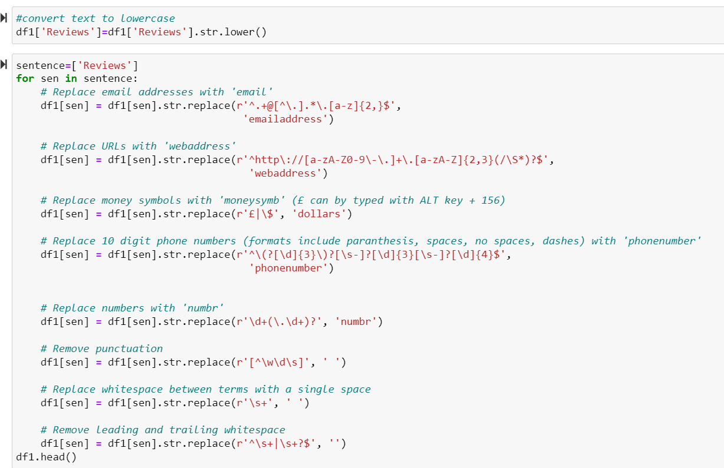
Pre Processing of review column.

Slide 11
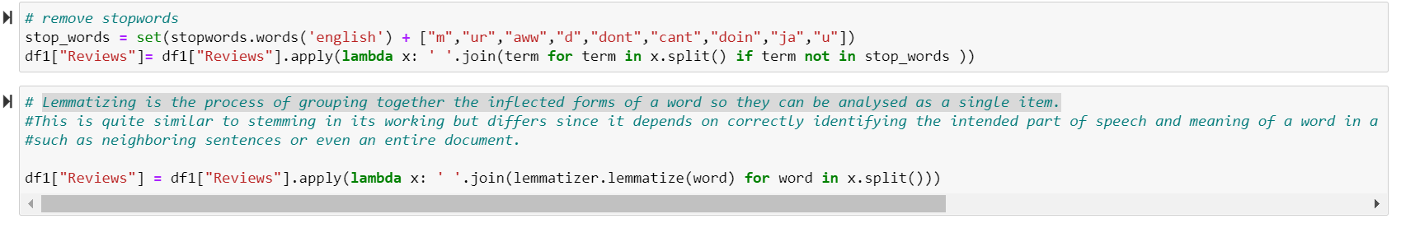
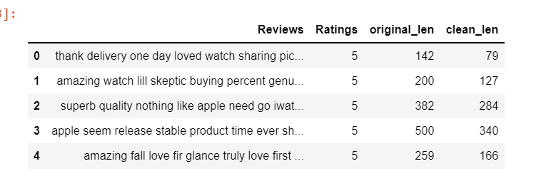
It can be seen that pre processing the review column definitely helps in reducing the length of the text, also all the unwanted words are drop from it make it suitable for NLP model.
At this level it is easy to find relation between the feature and the label, and hence we plot the word cloud for the different star ratings.

Slide 12
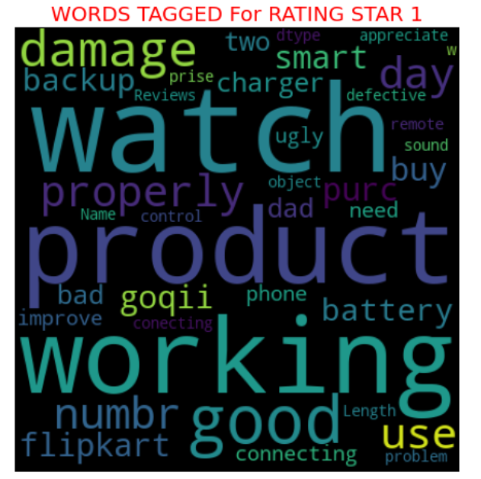
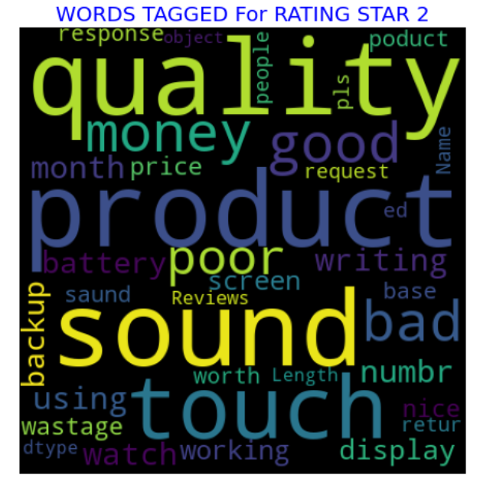

Slide 13
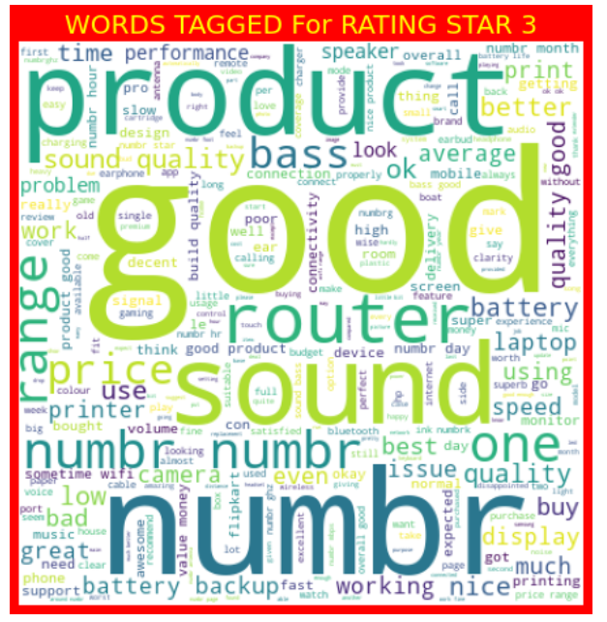
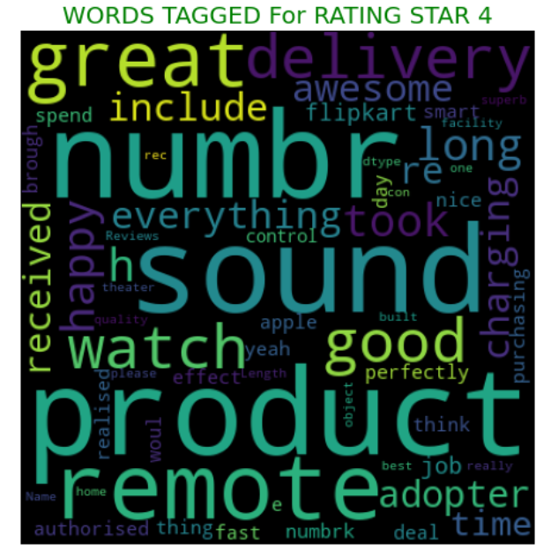

Slide 14
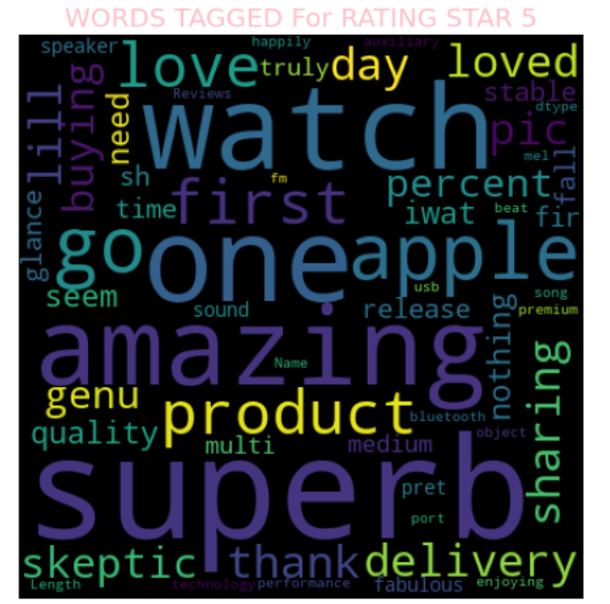
These word cloud gives an idea about the type of words which found in the reviews for star-1, star-2, star-3, star-4 and star-5.
The large font indicates those words which the very frequent in the reviews.

Slide 15
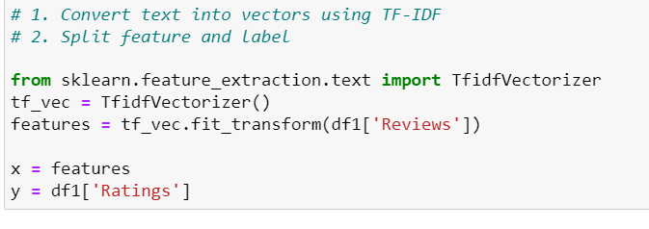
Encoding/ Vectorization:
As our text data is pre processed completely , its time to encode it to fit it in the Model building.
In NLP we use vectorization method to encode the pre processed text data. Here we are using TF-IDF to convert text to vector.

Slide 16
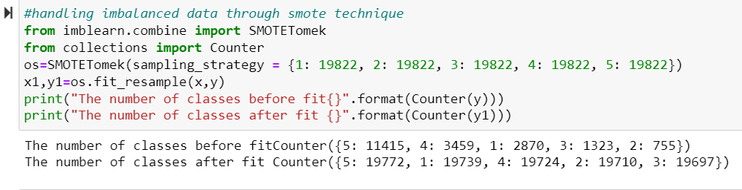
Model Development and evaluation:
Our vectorized data is then split into training and testing data set using which we develop and evaluate our model.
As we observe that our label classes are imbalanced so first we need to balance it using SMOTETomek technique. And then perform train test split.

Slide 17
Algorithms applied for training and testing dataset
1. Logistic regression
2. Decision Tree Classifier
3. MultinomialNB
4. Random Forest Classifier
5. AdaBoost Classifier
6. XGBoost Classifier
7. Bagging Classifier

Slide 18
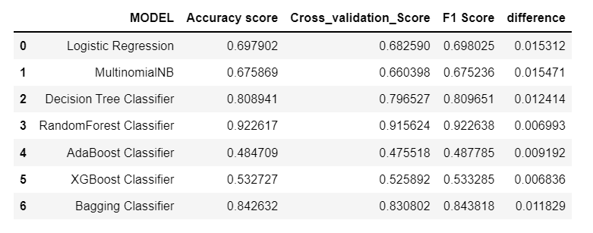
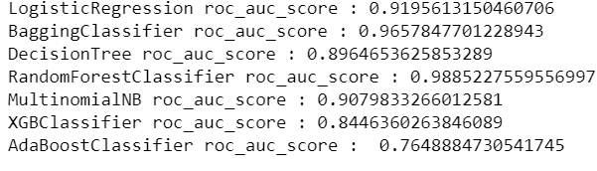
Summarizing each model
From above , it is clear that RandomForest Classifier outperforms all the other models. It has highest F1-score, cross validation score, accuracy score and also has highest value for roc_auc_score. Even the difference between the cross validation score and accuracy score is very low as compared to rest of the models. So our final model will be random forest Classifier.

Slide 19
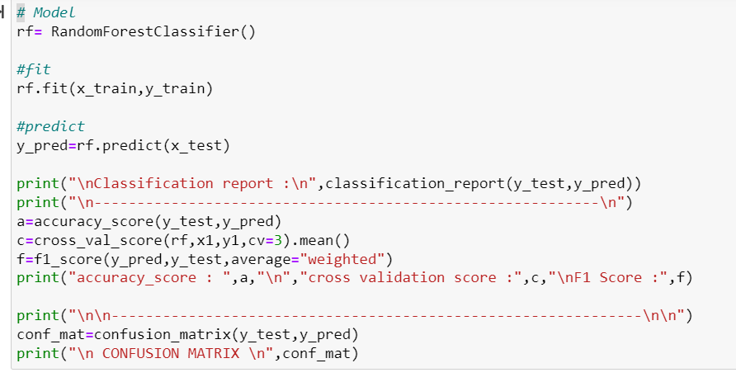
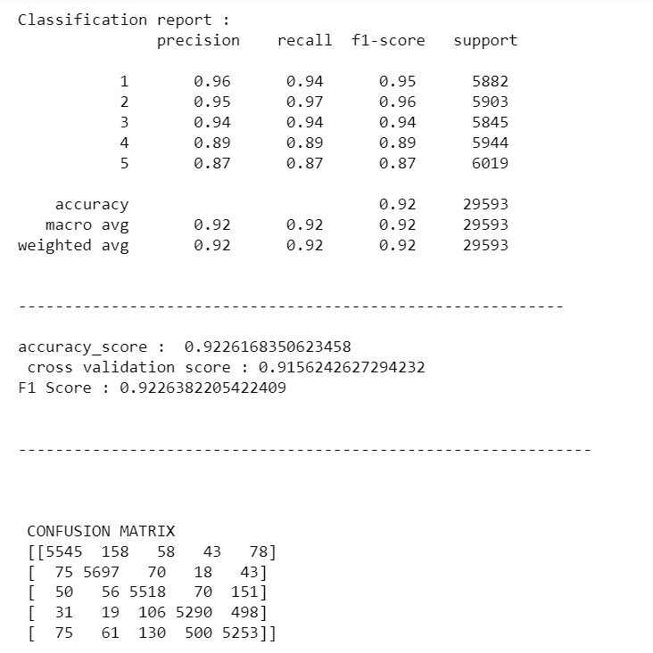
RandomForest Classifier
We can observe from the classification report, it has decent score for precision and recall as well. Over all Random forest seems to be best fit for our dataset. Let’s per hyper parameter tuning for it.

Slide 20
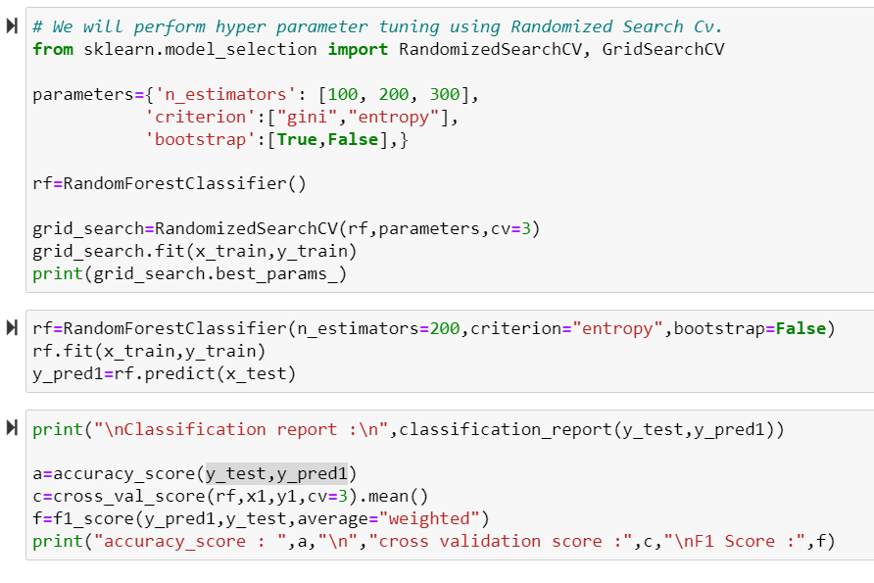
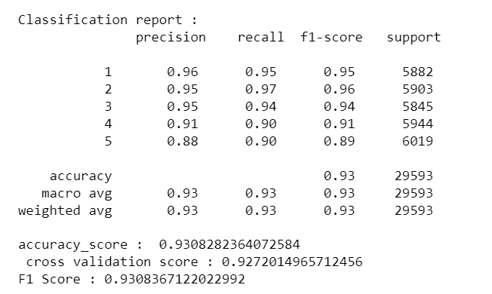
Hyper Parameter Tuning for Random Forest
From hyper parameter tuning we can see that there is slight increase in the scores of the model.

Slide 21
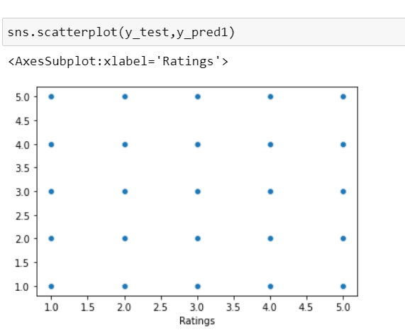
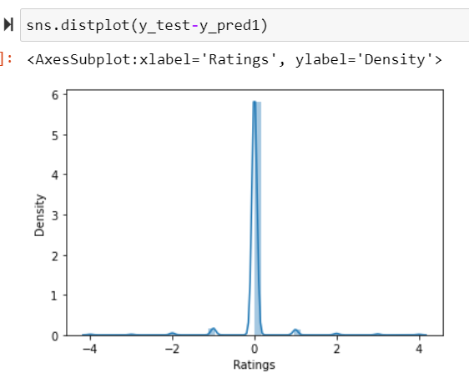
Visualization of random forest results.
From above plots it is clear that, RandomForest Classifier algorithm is the best fitted Algorithm for this data set, the predicted value and true values very well align.

Slide 22
Conclusion:
While collecting the data, we observe that more than 50% of reviews are for 5-star rating, we can get decent number of reviews for 4 star and 1 star rating but 3 and 2 star rating reviews are very less in number.
It looks like customer normally don’t reviews for average products, they either give high ratings or for poor performance product they give straight 1, no 2 star just 1 star rating. And if they are not satisfied nor dissatisfied, they give 3-star rating.
But to level out we perform smote technique so that the training model has sufficient data for 2-star data as well. We did over sampling here before training and testing the data.
There were some one liner reviews as well, but thing is they consist of all the required words which defines their rating.
It is always good to have visual rating besides reviews, as it helps to see the overall performance of the product.

Slide 23
Thank You

